Slide 1

AMAZON DATA ANALYSIS
Made By:
Piyush Upadhyay

Slide 2

Introduction
In the digital era, Amazon stands out as a leader in e-commerce, shaping consumer habits and market trends. This report analyzes Amazon sales data to extract insights into consumer behavior and product performance. By leveraging advanced data analysis, we aim to provide valuable insights for businesses to make informed decisions and drive strategic growth in the e-commerce sector

Slide 3
Problem Statement
Sales management has gained importance to meet increasing competition and the need for improved methods of distribution to reduce cost and to increase profits. Sales management today is the most important function in a commercial and business enterprise.
Do ETL: Extract-Transform-Load some Amazon dataset and find for me Sales-trend -> month-wise, year-wise, yearly month-wise.
Find key metrics and factors and show the meaningful relationships between attributes. Do your own research and come up with your findings.

Slide 4
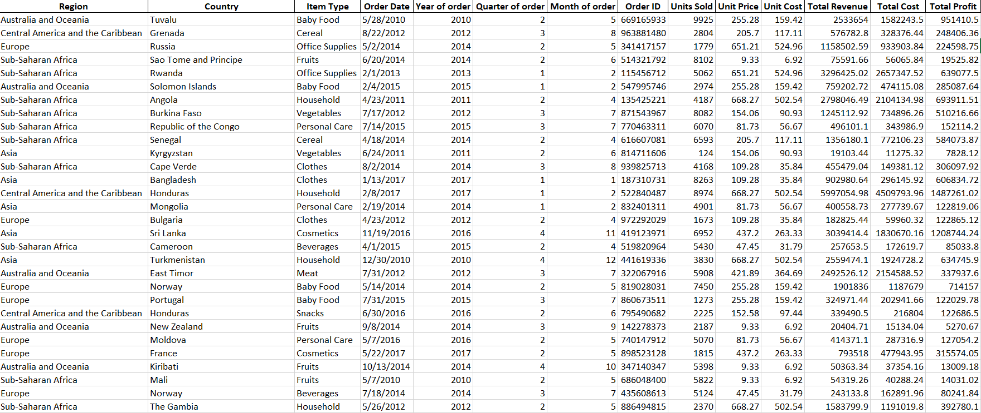
Cleaned Dataset

Slide 5

Main KPIs
Units Sold by Item type, in Regions.
Units Sold with Month, Quarter, Yearwise.
Profit by Item type.
Most profit by Regions.
Profit with Month, Quarter, Yearwise.
Sales by Item type.
Total Revenue by Regions

Slide 6
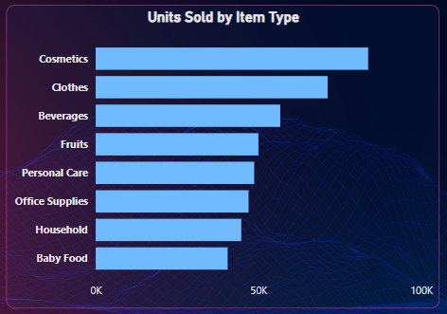
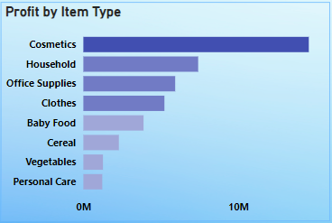
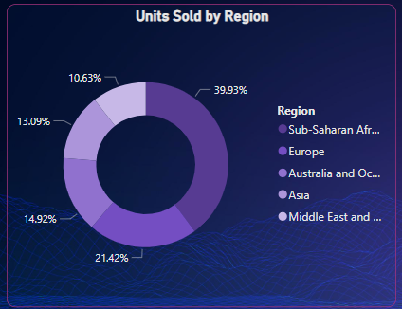
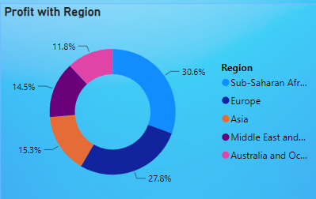
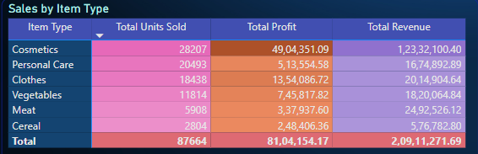
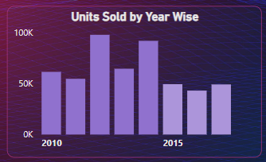
Charts Visualization

Slide 7
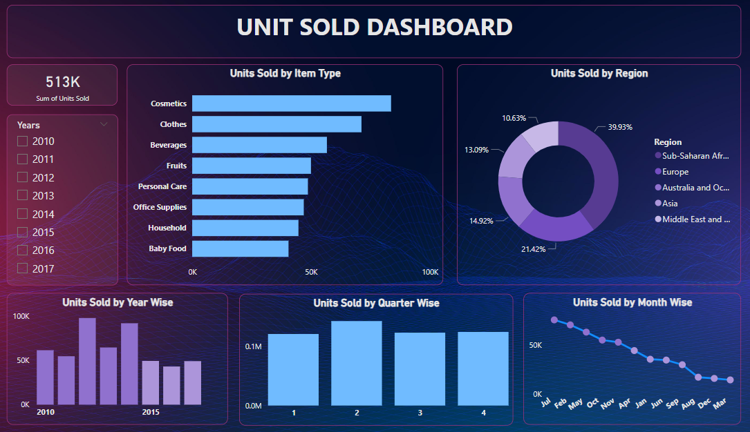
DASHBOARD

Slide 8
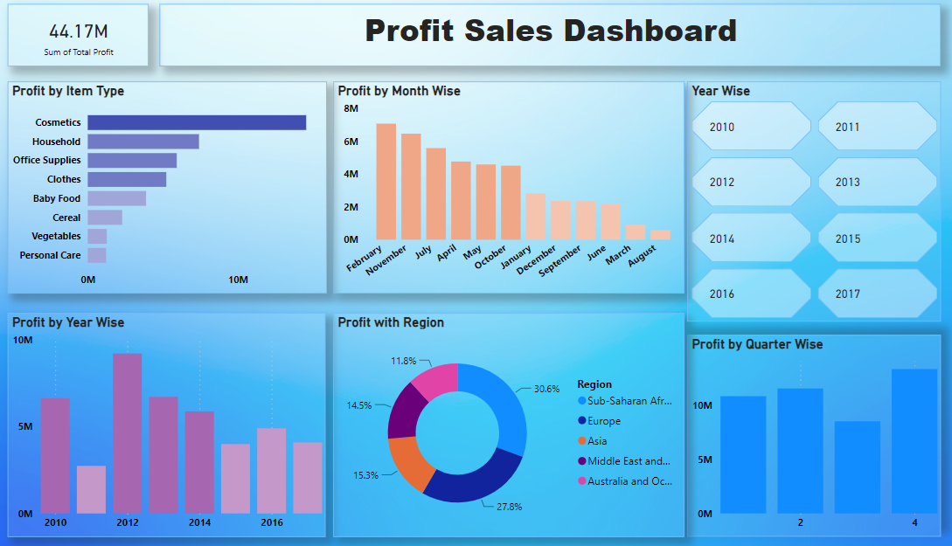
DASHBOARD

Slide 9
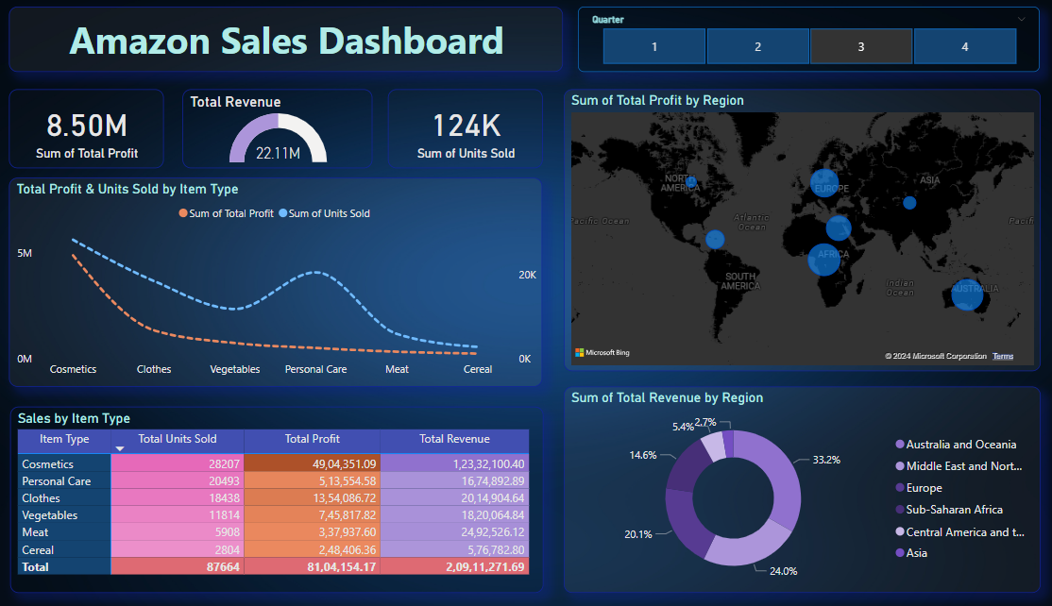
FINAL DASHBOARD

Slide 10
IN-SIGHTS
Cosmetics, Clothes, Beverages are top 3 Item types in Maximum Units Sold in overall data.
Maximum Units Sold in 2012,in the month of July with Most 2 Item types Personal Care & Vegetables .
Cosmetics Items provide the maximum profit to the company in overall data.
Year of 2012 comes with the maximum profit with Item types like Household, Office Supplies & Cosmetics.
Maximum Profit comes In the 4th Quarter of a Year for the Company in overall data.

Slide 11
Thank you

